Slide 1

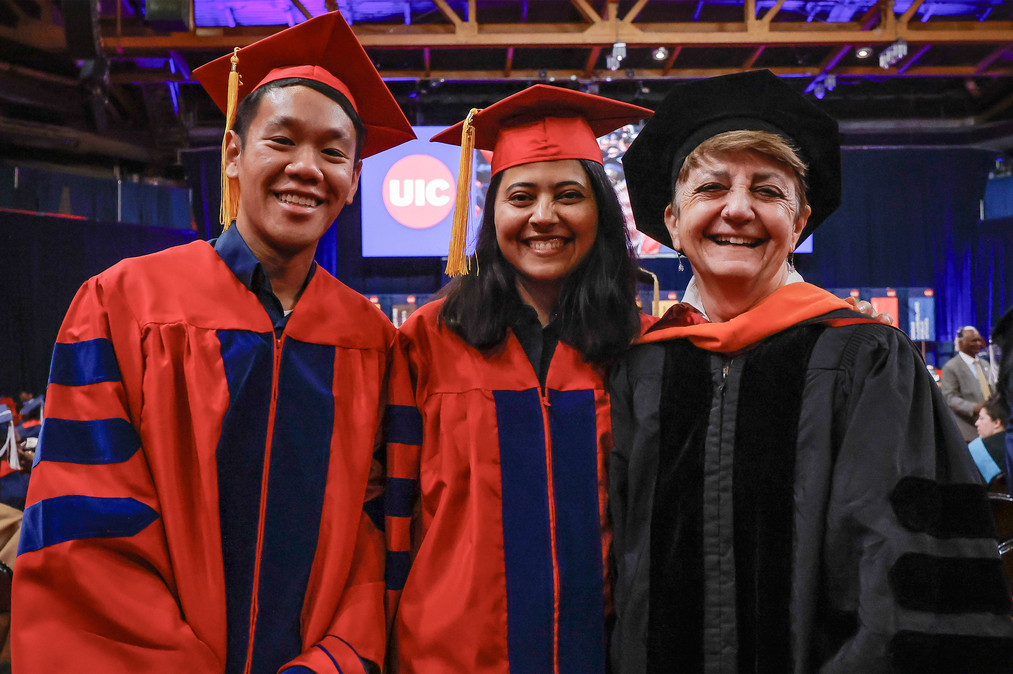
Temporal Reasoning in Clinical Narratives:
From Information Extraction to Early Disease Detection
Thanks to Rochana Chaturvedi
(based on her PhD thesis defense)

Slide 2

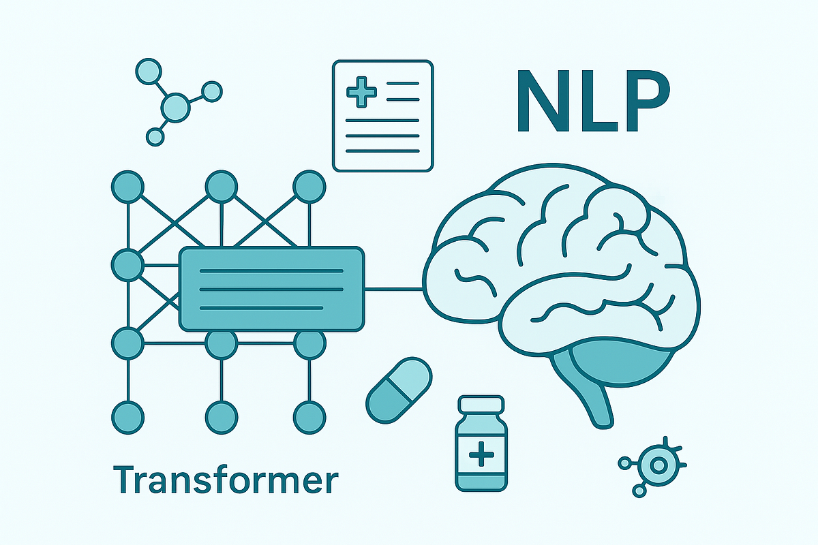
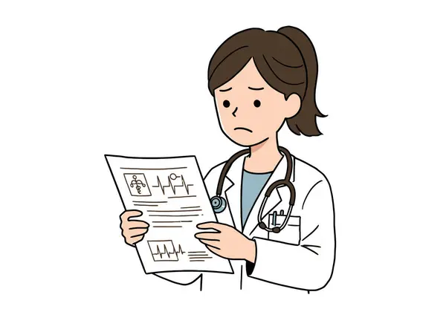
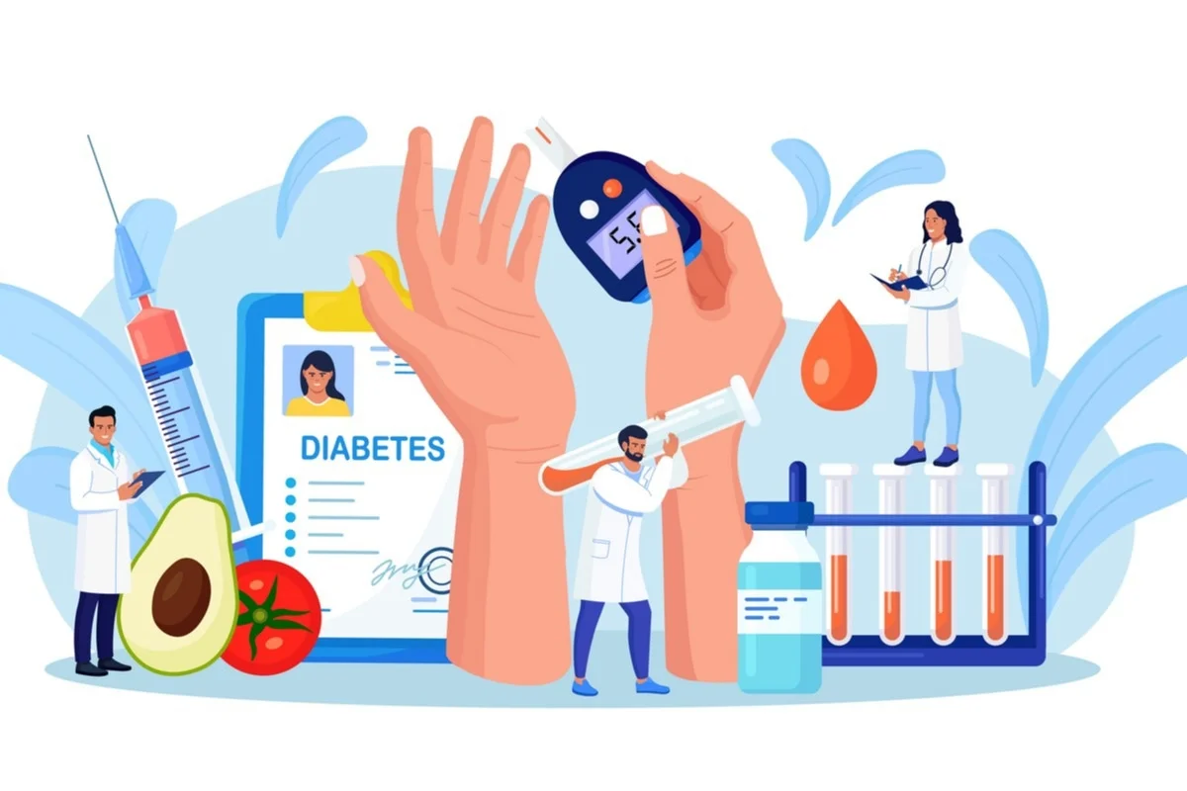

The Challenge: AI for Chronic Disease Risk Estimation
Type 2 Diabetes (T2D)
Half Billion Worldwide (and rising)
Early Diagnosis Important
Many undiagnosed: 50% UI Health Emergency patients and 23% in U.S
→ Need Opportunistic Screening systems (especially for
underserved populations lacking routine care)

Slide 3
The Challenge: AI for Chronic Disease Risk Estimation
Current Limitations
Structured EHR data noisy^{[1]}, lacks crucial context
Clinical Notes:
Manual review not scalable, leads to diagnostic errors
Existing AI models do not capture rich temporal context in notes
[1] Hersh et al. "Caveats for the use of operational electronic health record data in comparative effectiveness research." Medical care (2013)

Slide 4
Clinical Narratives and Temporally Grounded Methods
Clinical notes capture extensive details including temporal sequence of events:
Symptoms, diagnoses, and treatments evolve over time
Order matters: Drug after symptom ≠ Symptom after Drug
Solution: combine richness of clinical narratives & representational power of advanced AI tools (GNNs, language models) for structured and contextual reasoning over temporal cues
Expected Impact: Advancing the state of the art in clinical NLP and healthcare AI
End-to-end entity-temporal-relation extraction
Real healthcare decision support applications, e.g. opportunistic screening of T2D

Slide 5
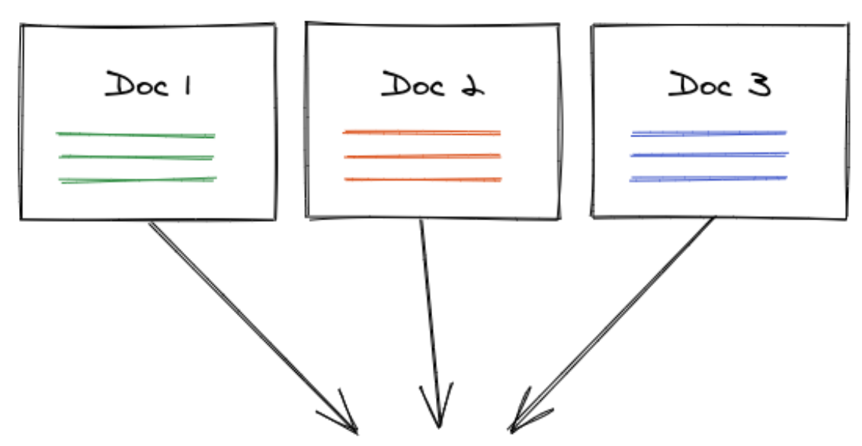
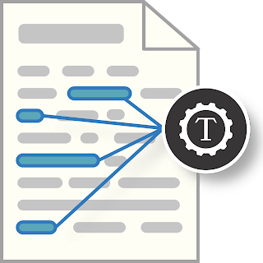
Presentation Roadmap
Visit-Level Temporal cues for T2D-risk prediction
T2D
after
Temporal Relation Extraction
TREx
overlap
before
Risk Prediction with Hierarchical Temporal Graphs
T2D
Conclusion and Future Directions

Slide 6
Part 1
Leveraging Visit-Level Temporal Cues
For Type 2 Diabetes Prediction
T2D

Slide 7

UI Health Data
Longitudinal EHR >10 years (Jan 1, 2010, to Jul 31, 2021)
Notes split into EPIC and CERNER (until Fall 2020) subset
Inclusion Criteria:
Adults
At least 2 outpatient visits in 24 months
Exclusion Criteria:
Diagnosis of Type 1 diabetes or other types of diabetes

Slide 8
Data Filtering: UI Health
* First Filtration Criteria: Only consider patients with some notes
Notes | T2D Patients| NoD Patients
Initial Data
01
3708168 | 15140 | 164910
Drop Pre-Diagnosed (Earliest_Dx_Date)
3146140 | 4138 |164910
Demographic Filters
2909417 | 3878 | 149673
(RACE not in [H, NA, AS]; ETHNICITY/GENDER != NI)
Note Type and Author types Filter
1451626 | 2369 | 108635
note length >100
1050839 | 2302 | 106222
LLM Filter
(adjusts Earliest_dx_Date)
1039043 | 1717 | 106222
Notes:
H=Hawaiian; NA=Native American; AS=Asian; drop prediagnosed visits or patients with one visit visits after first diagnosis. T2D/noD: it’s the ICD code

Slide 9
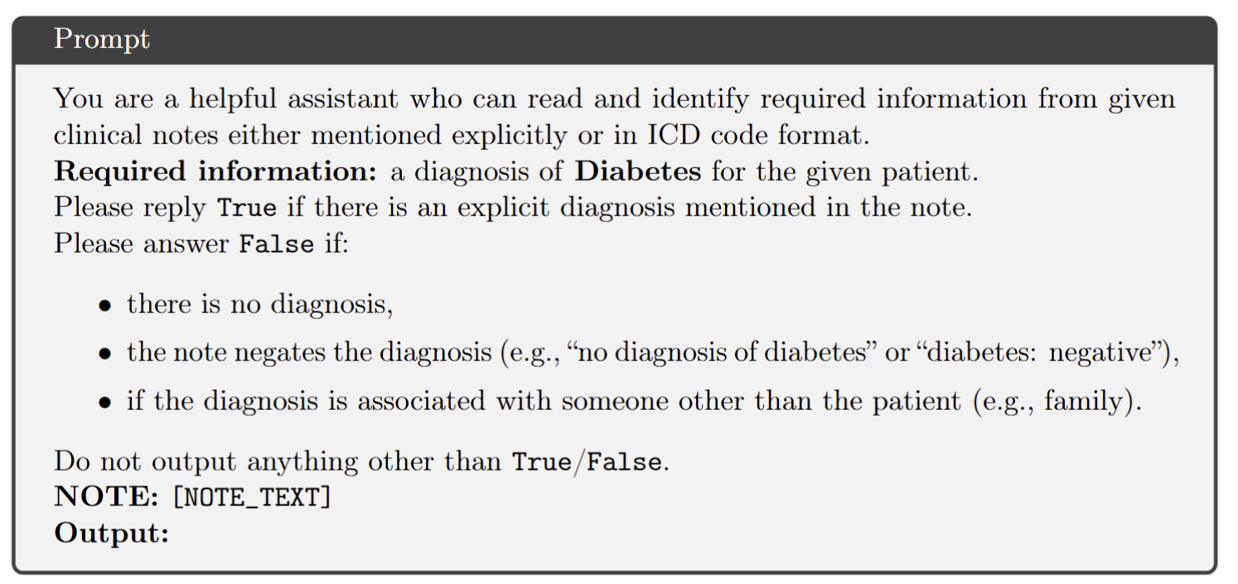
Data Cleaning Prompts
Example prompt instructing an LLM to identify explicit Diabetes diagnosis in a clinical note
Paraphrased version of above prompt with additional instruction to ‘not infer a diagnosis if not explicitly mentioned’
If answer is yes, move earliest diagnosis date back to current note date
Intersection of output of two prompts considered (yes if both answer yes, else no) based on manual checking of 50 examples (notes)
Notes:
Llama-3b – what happens is that sometimes diagnosis entered much later as an ICD code.

Slide 10
Event Extraction from Unstructured Clinical Notes
with cTAKES^{[1]}
extracts clinical concepts from text
maps synonymous concepts to unique identifiers (CUI) in UMLS^{[2]} clinical knowledge graph
Patient with a history of diabetic foot and foot checkup. Patient states the toenails are thick, elongated, unable to trim on her own. Patient denies any recent history of trauma. Debrided nails today.
ANATOMY DISEASE/DISORDER SIGN/SYMPTOM MEDICATION
[1] Savova et al. “Mayo clinical text analysis and knowledge extraction system (ctakes): architecture, component evaluation and applications,” JAMIA. 2010.
[2] Bodenreider "Using UMLS semantics for classification purposes." AMIA Symposium. 2000.

Slide 11
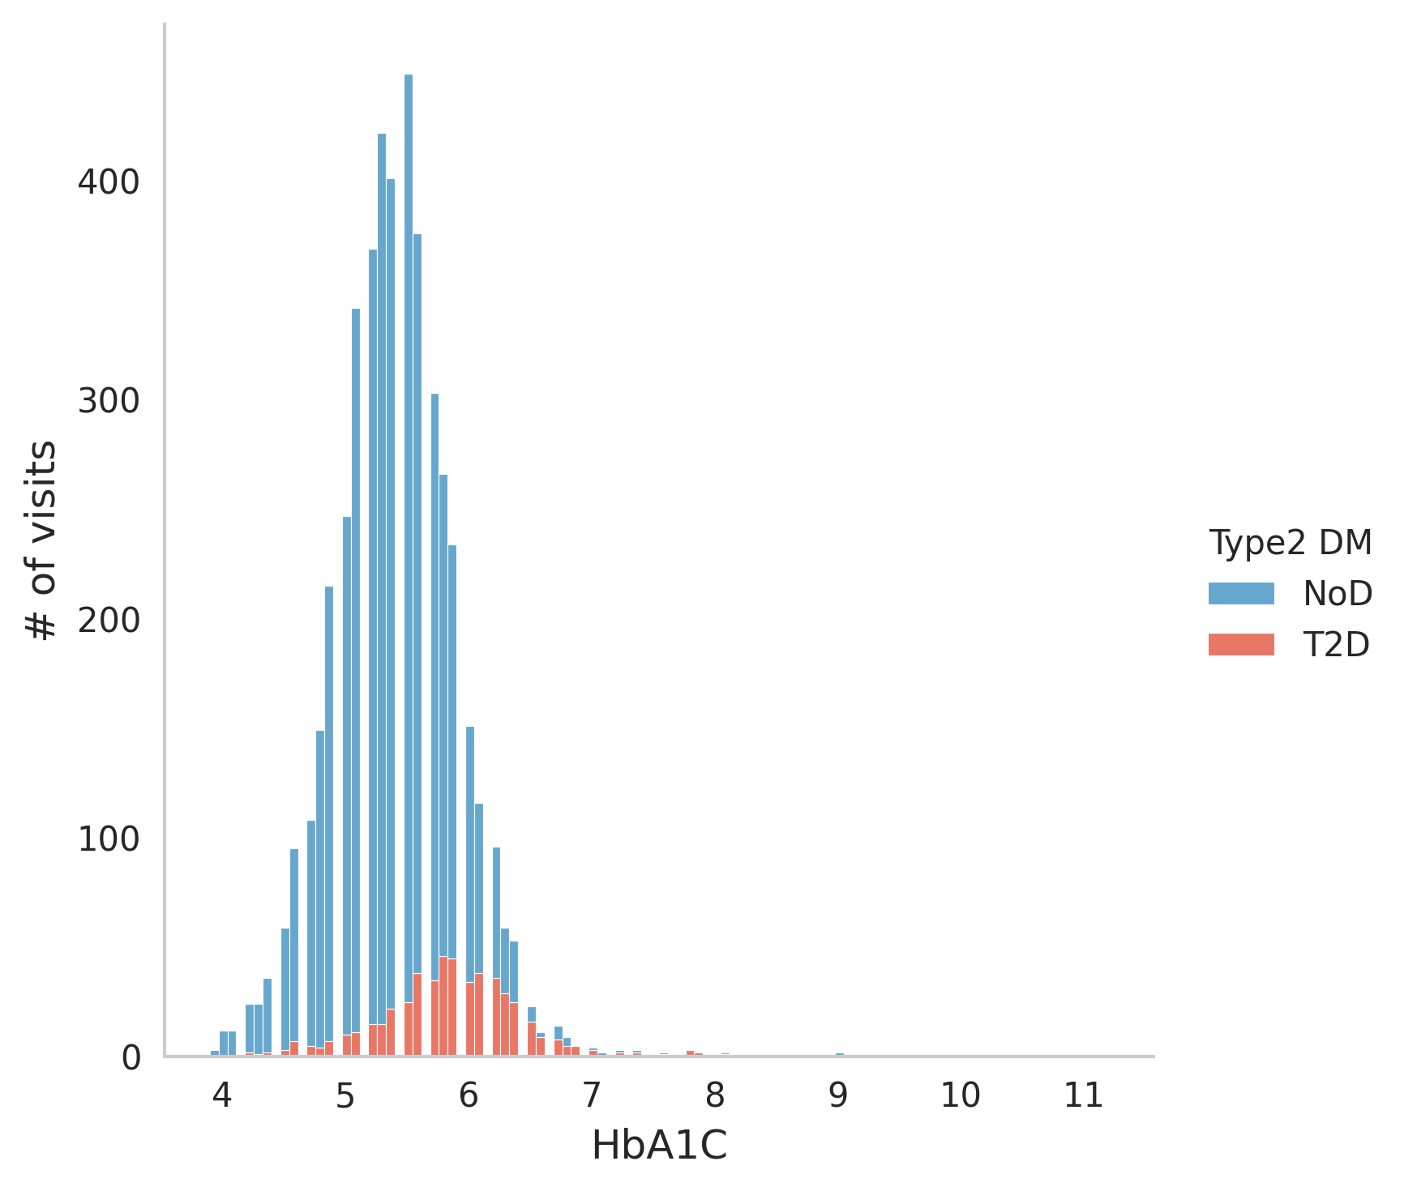
Leveraging Structured Data
HbA1C Time-series
Test for T2D
Diabetic if HbA1C > 6.5^{[1]}
Noisy and sparse (missing from 56.8% observations) leading to missed diagnoses
Demographic Attributes
Details »
[1] El Sayed, Nuha A., et al. "2. Classification and diagnosis of diabetes: standards of care in diabetes—2023." Diabetes care 46. (2023)

Slide 12
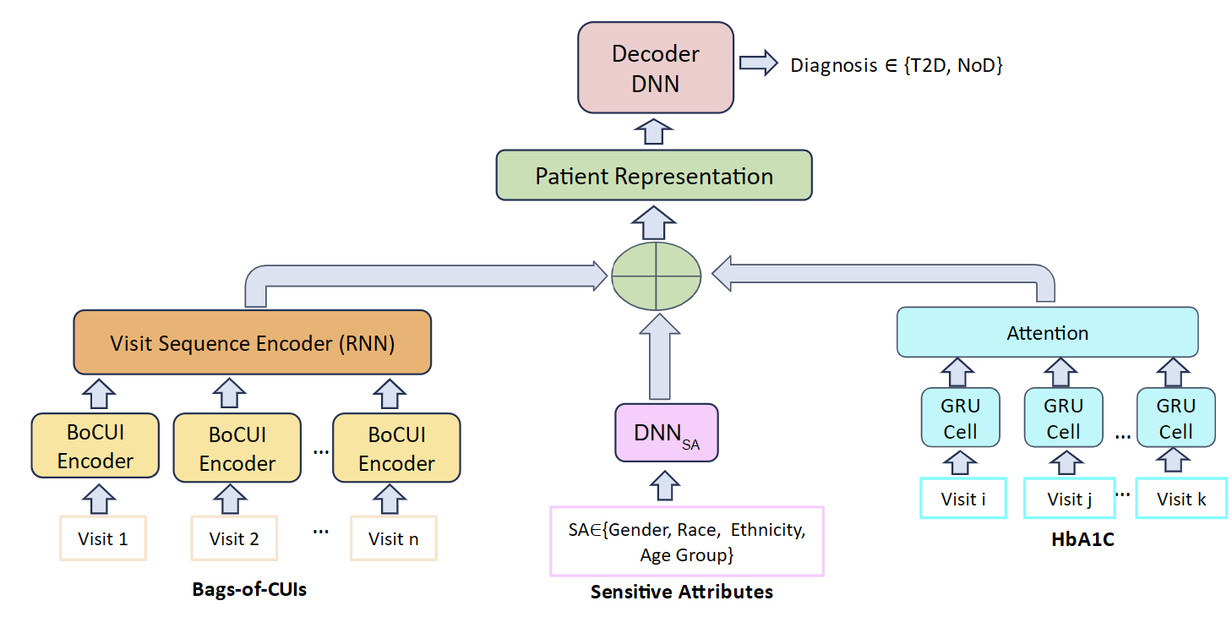
Method and Result Summary
Clinical concepts from notes improve
performance over structured EHR
Additional gains from Temporal
modeling of events over visits
Evaluation Details »

Slide 13
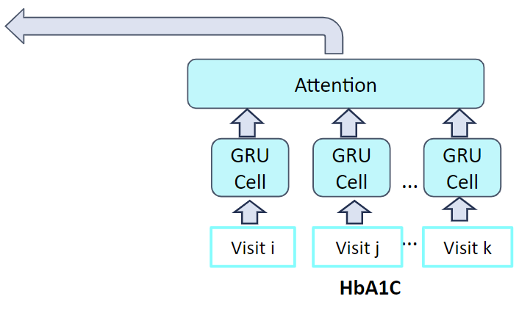
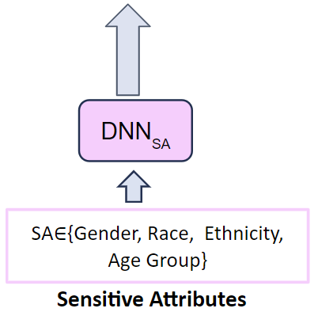
Model Architecture
Decoder
DNN
Diagnosis ∈ {T2D, NoD}
Patient Representation
Visit Sequence Encoder (LSTM)
BoCUI
Encoder (CNN)
BoCUI
Encoder (CNN)
BoCUI
Encoder (CNN)
…
Visit 1
Visit 2
…
Visit n
Bags-of-CUIs (cui2vec)^{[1]}
[1] Beam, Andrew L., et al. "Clinical concept embeddings learned from massive sources of multimodal medical data." Pacific Symposium on Biocomputing 2020.

Slide 14
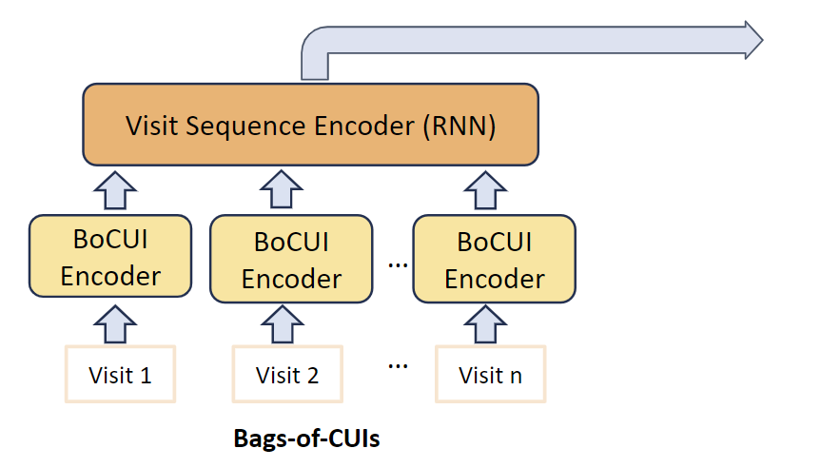
Model Architecture
Decoder
DNN
Diagnosis ∈ {T2D, NoD}
Patient Representation
DNN_{SA}
SA∈{Gender, Race, Ethnicity, Age Group}
Sensitive Attributes

Slide 15
» Back
Model Architecture
Decoder
DNN
Diagnosis ∈ {T2D, NoD}
Patient Representation
Attention
GRU Cell
GRU Cell
GRU Cell
…
Visit i
Visit j
…
Visit k
HbA1C

Slide 16
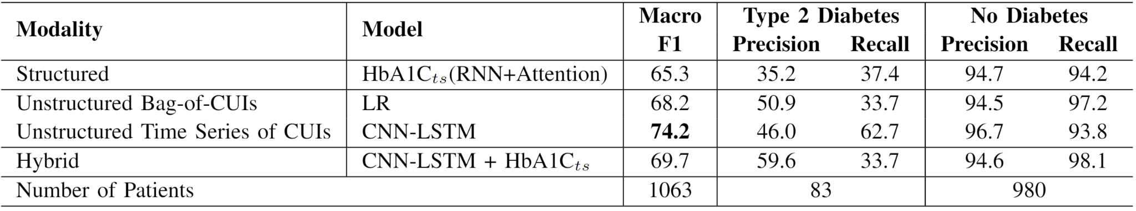
» Back
Evaluation Summary
HbA1C time series model has best performance among structured models

Slide 17
» Back
Evaluation Summary
Clinical concepts improve performance
Temporal modeling of concepts gives best performance

Slide 18
» Back
Evaluation Summary
Adding structured to unstructured reduces recall of T2D class

Slide 19
» Back
Subgroup Biases
Lower performance for Females despite being majority
Hybrid models with HbA1C test benefit the White group only

Slide 20
Key Research Questions
RQ : Can fine-grained temporal information improve patient
representation hence risk prediction?
2
RQ1: Can we improve temporal relation extraction from
clinical notes?

Slide 21
Part 2
End-to-end Temporal Relation Extraction
from Clinical Text
(ACL 25)
after
TREx
overlap
before

Slide 22
Temporal Relation Extraction (TREx)
TLINK
Overlap
ADMISSION DATE: 03/24/97
DISCHARGE DATE: 03/28/97
The patient was admitted for her gait disorder …
She was initially placed on heparin for two days, until her MRI results were obtained.
gait
disorder
admitted
Heparin
MRI
Before
After
Events
PROBLEM
OCCURRENCE
TREATMENT
TEST
DATE
DURATION
03/24/97
two days
03/28/97
ADMISSION
DISCHARGE
TimEx
time

Slide 23
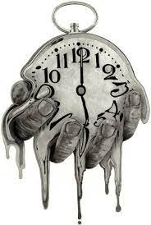
Challenges
Clinical jargon
Abbreviations: b.i.d (twice a day)
Synonyms: T2DM/T2D/DM2/Diabetes Type 2
Homonyms (context shapes meaning):
DM2 ~ Type 2 Diabetes/Dystrophia Myotonica Type 2
Implicit temporal dependencies:
(A before B) & (B before C) → (A before C)
Long documents, O(n²) pairs challenge for transformer-based models

Slide 24
Solution: Graph-based Temporal Relation Extraction (GRAPHTREX)
Large clinically pre-trained language models (LPLM)
Learn local, contextualized representations from text but
Don’t capture global, long-range dependencies
Graph Neural Networks (GNN)
Excel in relational reasoning, but
Need semantic-rich embeddings from LPLMs
Our Solution: GRAPHTREX
Fuses LPLMs with heterogeneous GNNs for contextual and structured extraction and
Applies sliding windows to handle long document context

Slide 25
Heterogeneous Document-Level Graph
Innovative Local and Global Landmarks
Context Nodes: capture context between two entities
Temporal Edges
Window Nodes: bridge distant entities
before HGT
after HGT
[CLS]₁ admission date: 12/04/18 . the patient was initially hypot ##ensive … [CLS]₂ she had a mechanical fall after admission.

Slide 26

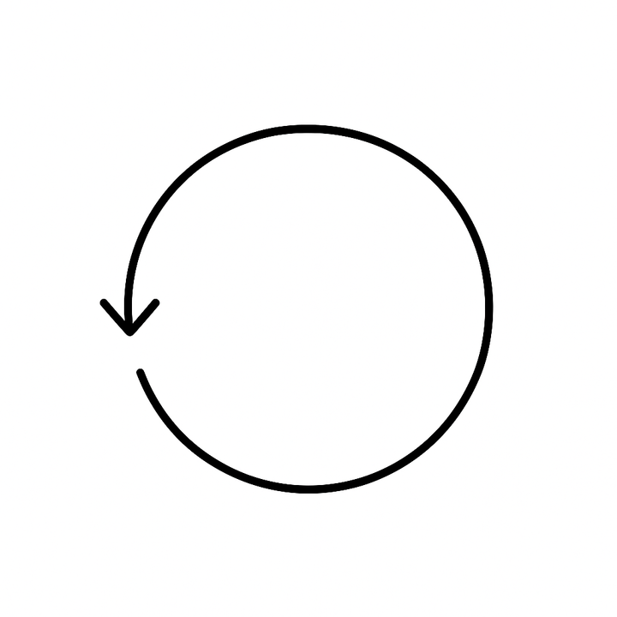

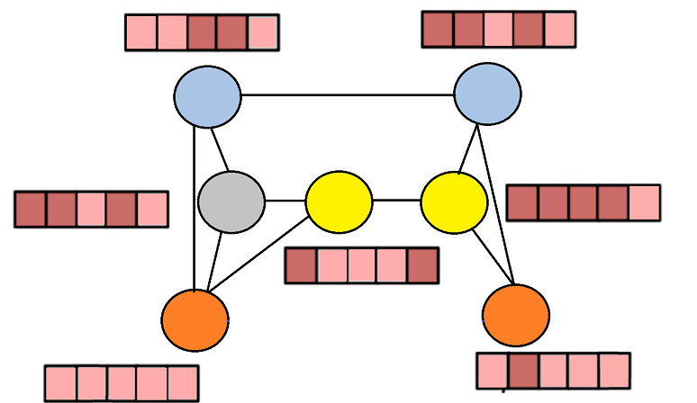
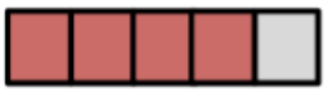
Graph-based Temporal Relation Extraction (GraphTREx)
SpanTREx
(I)
CLS₁
CLS₂
Landmarks Nodes
Relation Decoder (f)
HGT
admission
12/04/18
Pair Embedding 𝟄_{ij}
(II)
admission
hypotensive
(V)
mechanical fall
NONE
DATE
OCCURRENCE
PROBLEM
(III)
(IV)
Entity Decoder (g)
⊕
Relation Decoder (f)
Span Embedding e_{sp}
BioMedBERT
admission date: 12/04/18. the patient was initially hypotensive … she had a mechanical fall after admission.
26

Slide 27


Dataset Overview
I2B2 2012 Corpus^{[1]}
310 discharge summaries
~35K entities
~61K relations
E3C Corpus^{[2]}
84 clinical case reports
~5K entities
~4K relations
[1] Sun, Rumshisky & Uzuner ”Annotating temporal information in clinical narratives”. JBI. 2013.
[2] Magnini et al. European clinical case corpus. In European Language Grid: A Language Technology Platform for Multilingual Europe. 2022

Slide 28
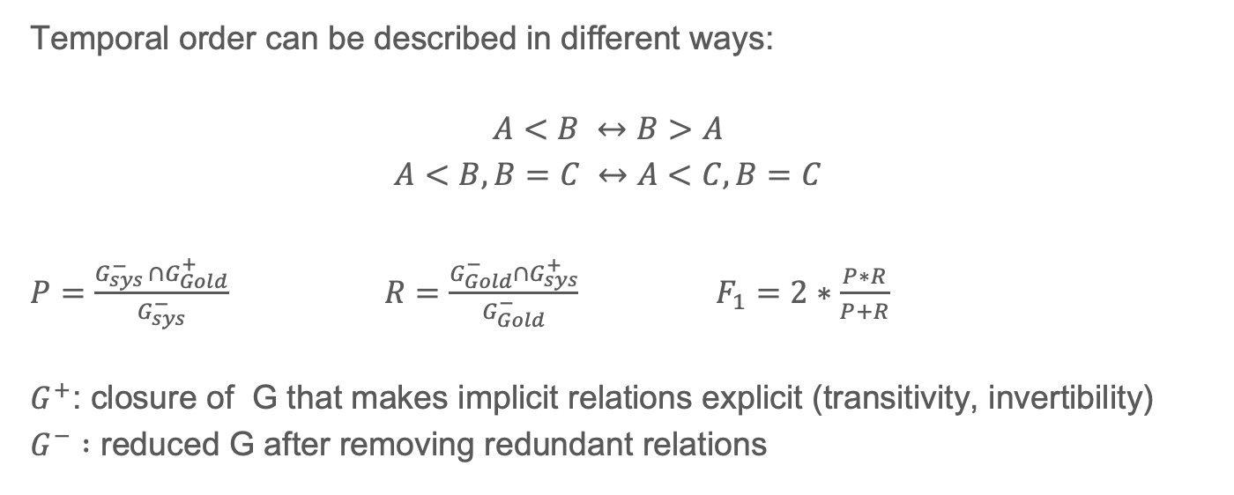
Tempeval … evaluation: TLink F1
Temporal order can be described in different ways:
$$A<B ↔B>A$$
$$A<B, B=C ↔A<C,B=C$$
$P=\frac{G_{sys }^{−}∩G_{Gold}^{+}}{G_{sys}^{−}}$ $R=\frac{G_{Gold}^{−}∩G_{sys}^{+}}{G_{Gold}^{−}}$ $F_{1}=2∗\frac{P∗R}{P+R}$
$G^{+}$: closure of G that makes implicit relations explicit (transitivity, invertibility)
$G^{−} :$ reduced G after removing redundant relations

Slide 29
Evaluation
 | Model | I2B2 Tempeval^{[3]} F₁ | E3C Micro F₁
 | Rules +ML Hybrid ^{[1]} | 63.4 | NA
 | SPERT^{[2]} | 61.1 | 13.6
 | SPANTREX | 66.6 | 22.6
 | GRAPHTREX | 68.8 | 23.5
Baselines
Ours
New state-of-the-art on I2B2 2012 end-to-end relation extraction > 5% improvement
Consistent improvements on E3C corpus
[1] Xu Y, Wang Y, Liu T, Tsujii J, Chang EI. An end-to-end system to identify temporal relation in discharge summaries: 2012 i2b2 challenge. JAMIA. 2013.
[2] Eberts M, Ulges A. Span-based joint entity and relation extraction with transformer pre-training. ECAI. 2020.
[3] UzZaman N, Allen J. Temporal evaluation. ACL. 2011.

Slide 30
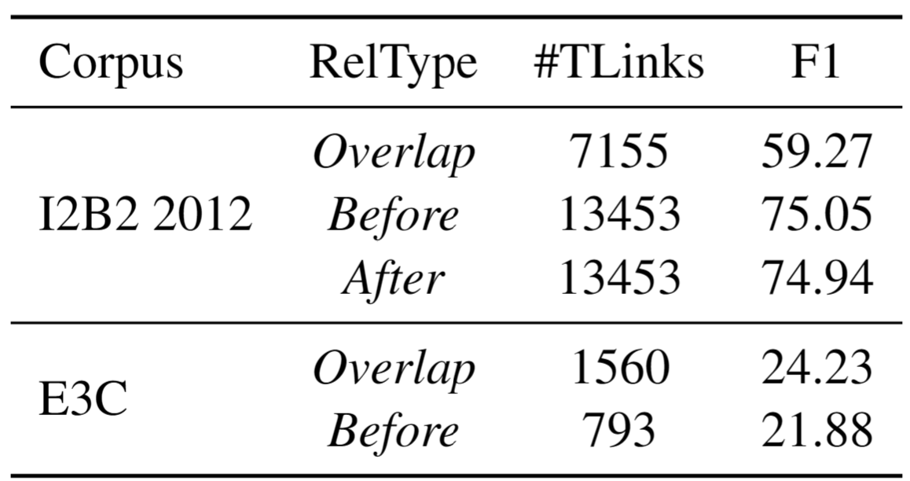
Performance Across Relation Types

Slide 31
What makes GraphTREx Work: Landmark Nodes
Entity | Landmark Nodes |  | % IMP
 | Context | Window | I2B2 2012 | E3C
✔ |  |  | -3.3 | 0.8
✔ | ✔ |  | 1.9 | 4.1
✔ |  | ✔ | 1.3 | 3.7
✔ | ✔ | ✔ | 2.3 | 1.9
I2B2 2012: Both landmark nodes enhance performance
E3C: short documents, window nodes create noise
Additional robustness experiments across base encoders, pair embedding approaches
Details »

Slide 32
Performance Across Distant Entities
Consistent improvement (%IMP) from GRAPHTREX over SPANTREX across:
d=0: Nearby pairs (within the same window)
d>0: Distant pairs (spanning different windows)
d>1: Farther pairs (across two or more windows)
Pair Distance | % IMP
d=0 | 4.5
d>0 | 6.7
d>1 | 8.9

Slide 33
Case Study: Temporal Graphs from a Snippet from I2B2 2012
OVERLAP
BEFORE
treatment
10/9/95
tolerated
daily
10/9/95
10/9/95
tolerated
four days
DISCHARGE
treatment
DISCHARGE
daily for four days
DISCHARGE
four days
DTIC
discharged
discharged
DTIC
daily
discharged
Adriamycin
10/5/95
10/5/95
10/5/95
Adriamycin
DTIC
hydrated well
ADMISSION
ADMISSION
hydrated
ADMISSION
Adriamycin
GROUND-TRUTH
SPANTREX
GRAPHTREX

Slide 34
Key Contributions
Introduce GRAPHTREX, a novel integration of GNNs and LPLMs with innovative landmark nodes
SOTA on End-to-end clinical temporal relation extraction
Especially improves predictions on long-range relations
Groundwork for Event Sequencing in Clinical Narratives
Can TREx models be integrated into clinical decision support to improve patient representation hence health-risk prediction? (RQ2)
How well do TREx models transfer to a new setting with real-world data

Slide 35
Transfering TREx Models: from I2B2 to UI Health
Key Differences in Data Distribution:
UI Health Sample
9 clinical notes
2 patients
Expert Collaboration
I2B2: subsections of discharge summaries
UI Health: Progress notes, family medicine, endocrinology notes, etc.
Institutional Factors: Different hospitals, EHR, authors
Patient Demographics

Slide 36
Annotation Categories
Deidentification
PHI removal (HIPAA)
Realistic substitution
Entity Annotation
Events, TimEx
Silver Standard with SpanTREx
Annotation guidelines extended from I2B2
Coreference
Silver standard linking: Events (Metamap), Date (Microsoft Recognizers text )
Timeline (TLINK)
Temporal relations Cross-document

Slide 37
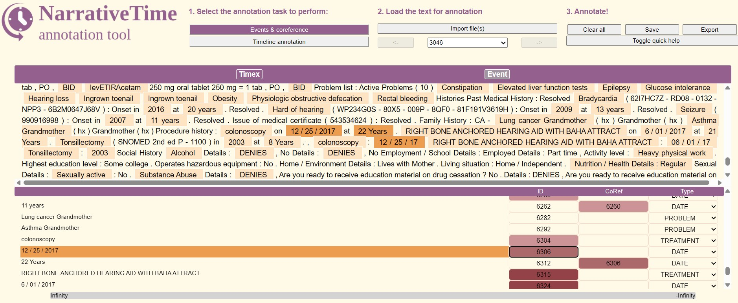
Entity/Coreference Annotation Interface
» Back

Slide 38
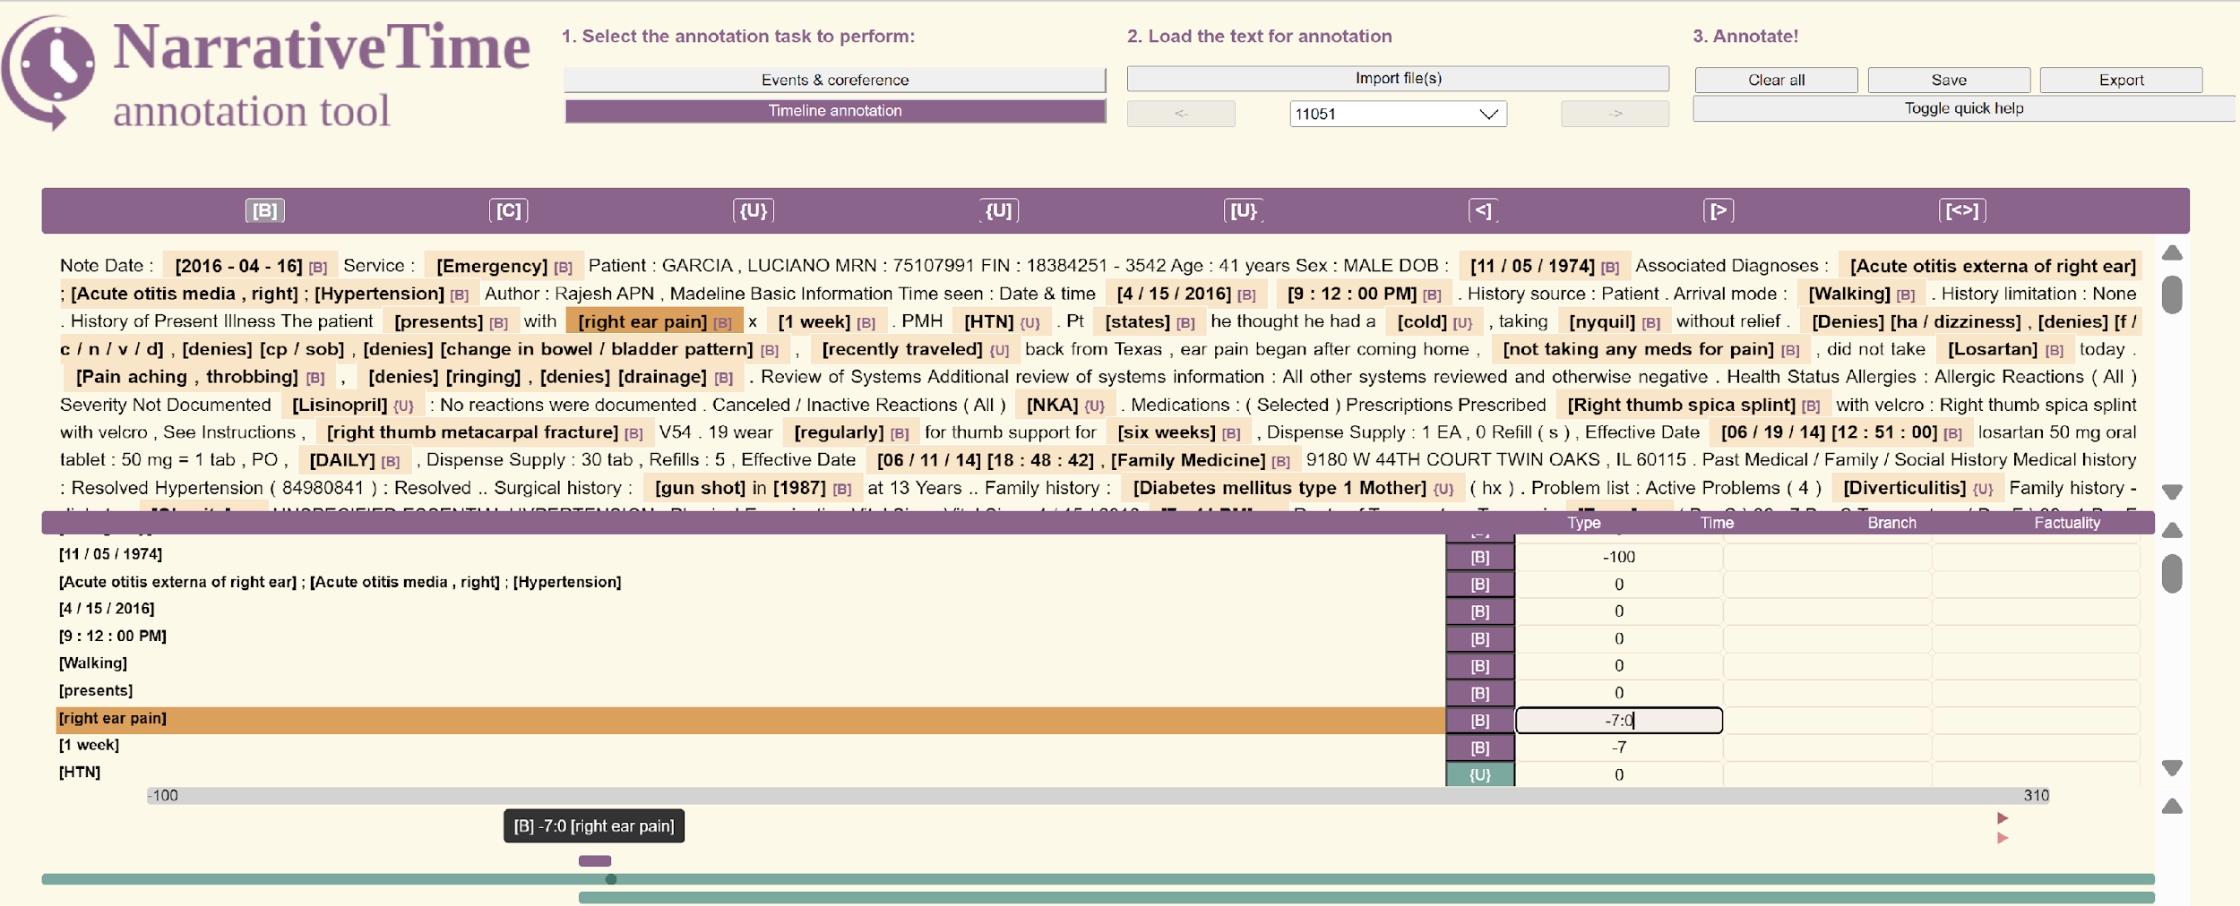
Timeline Annotation Interface
» Back
Notes:
Type is the time reference. 0 time of the note; 7:0: for a week etc

Slide 39
Annotation Statistics
10,936 Tokens
1,857 entities
558 Coref Pairs
700 head entities to timeline
279,560
non-Vague
TLinks

Slide 40
Evaluation
Model | Event _{(F1)} | Timex _{(F1)} | TLINK _{(F1)}
SPANTREX | 74.4 | 69.5 | 38.0
GRAPHTREX | 73.5 | 68.4 | 52.0
Entity Extraction: SPANTREX slightly outperforms
Temporal Relations: GRAPHTREX achieves 14% improvement in TLink F₁

Slide 41
Part 3
Disease Risk Prediction
with
Temporal Graphs
T2D

Slide 42
Complementary Perspectives
RQ2 : Can fine-grained temporal information improve patient
representations hence risk prediction?
Hit-GNN (similar to GraphTrex)
RQ3 : How to adapt LLMs demonstrating excellent reasoning
abilities in low-resource settings?

Slide 43

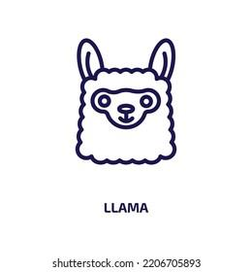

ReVeAL: Reasoning with Verifier Aided Labeling
Inference time scaling framework for Explainable Disease Prediction with LLMs
Large Reasoner (Llama3.1 8B)
Generates predictions with explanations
Scaling with diverse reasoning paths
5/training example
10/test example
Small Verifier (Llama3.2 1B)
Validates reasoning from larger model
Fine-tuned with LoRA
Input + reasoning from large model
Assigns confidence scores (normalized token probability of correct/incorrect)
Training with hard cases (reasoner answers mix of true/false over different paths)
Inference with top-k (3) majority vote
Notes:
An Inference Time Scaling (ITS) framework for Large Language Models (LLMs) is a system or strategy that improves model performance during inference (runtime) by allocating more computation, reasoning steps, memory, or search after the model has already been trained.
The key idea is:
Instead of only scaling model size and training data, you scale the amount of computation used while answering a query.
This is becoming a major paradigm in modern AI systems (e.g., OpenAI reasoning models, DeepSeek-R1, Tree-of-Thoughts, ReAct, Monte Carlo reasoning, self-consistency decoding).
LoRA stands for Low-Rank Adaptation. It is a technique for fine-tuning large language models efficiently without updating all the model parameters.
Instead of retraining billions of weights, LoRA trains only a small number of additional matrices.

Slide 44
LLM Baselines
Comparisons with Llama3.1-8b: zero-shot/self consistency^{[1]} (10 reasoning paths)
Comparisons with Llama3.2-1b: zero-shot/fine-tuned
Prompting Strategy:
Prompts include
Patient demographic attributes (age, race/ethnicity, gender),
Last n notes with visit dates (chronological order)
Reasoner: asked to generate explanation + risk (True/False)
Fine-tuned model: only generates risk
Verifier (in ReVeAL): reads above inputs + reasoner output (explanation & classification) and generates verification (correct/incorrect)
[1] Wang et al. "Self-Consistency Improves Chain of Thought Reasoning in Language Models." ICLR 2023

Slide 45
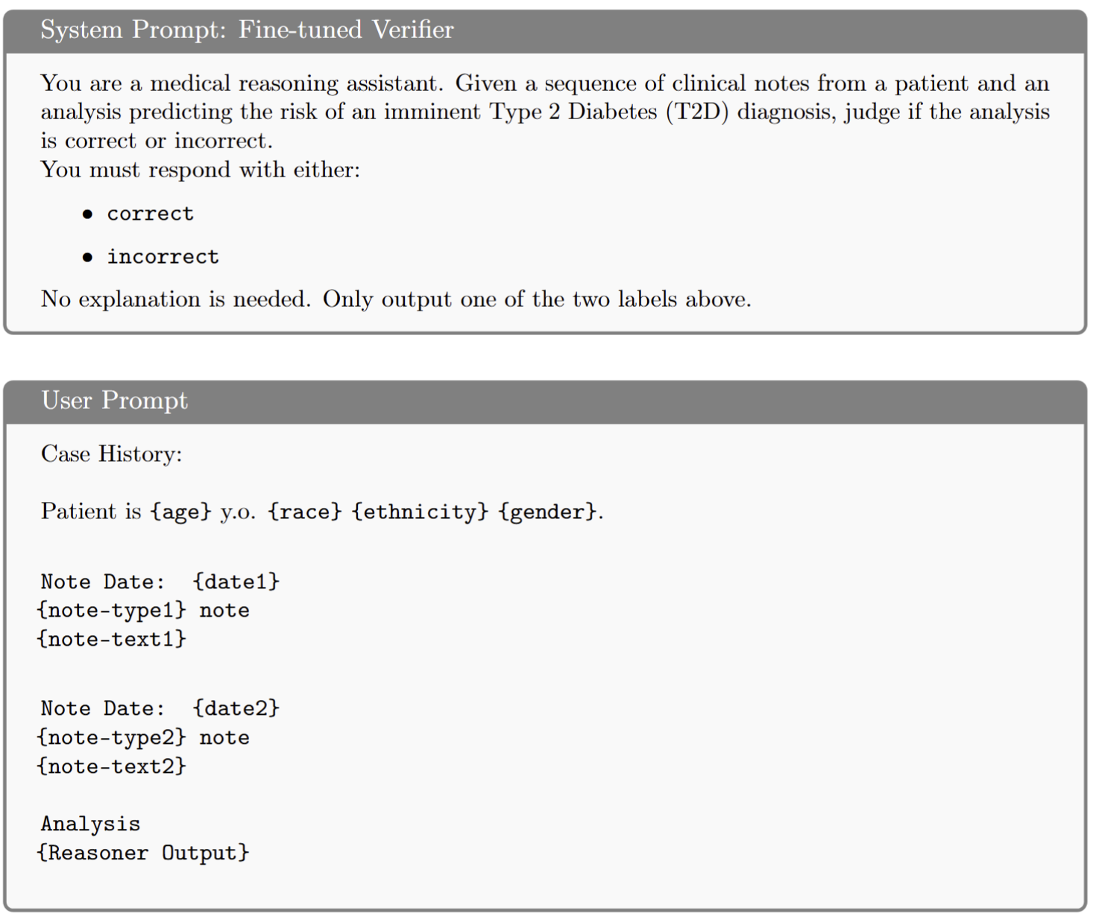
Prompts
Fine-tuned LLM verifier prompt to validate the prediction of a large reasoner
from patient demographics and sequence of clinical notes and reasoner explanation
Notes:
System prompts and user prompts are separated because they serve different roles in controlling the model’s behavior.
The system prompt defines:
the assistant’s identity,
global behavior,
policies,
constraints,
priorities,
style,
safety rules.
The user prompt contains:
the actual request,
task-specific instructions,
questions,
conversation goals.
W/o system / user prompt, LLM cannot distinguish core operating rules from temporary user requests

Slide 46
Dataset Characteristics and Insights
UI Health
3332 (712 in test set) patients
Strengths: Rich longitudinal histories, diverse note types, ideal for chronic disease modeling
Limitation: Private data
MIMIC-IV
5802 (291 in test set) patients
Strength: Public data
Limitations:
ICU-focus (omit large parts of a patient’s overall hospitalization timeline)
Narrower temporal windows limit exposure to longitudinal patterns (84.5% single visits)
Missing temporal anchors (dates redacted for de-identification)
Key Insight: MIMIC-IV results would represent a lower bound for achievable real-world performance

Slide 47
Model Evaluations
Details »
UI-Health
HiT-GNN achieves best AUC (72.2%), +4% over CLSTM (Part1)
Best LLMs:
Llama-1b-ft (AUC: 65.1%)
ReVeAL (F1: 65.2%)
MIMIC-IV
HiT-GNN leads in T2D recall (63.3%)
Best LLM: Llama-1b-ft (AUC 64.4%, 1.5% > HiTGNN)
Note: Llama-1b is the weakest model without fine-tuning; but fine-tuning sacrifices explainability. ReVeAL provides a balanced trade-off

Slide 48
Conclusion & Key Contributions
Unlocking the temporal structure from clinical narratives leads to improved patient representations
Algorithmic Innovations
📊State-of-the-Art TREx methods (SpanTREx, GraphTREx): with innovative landmark nodes
🧱Hierarchical Temporal Modeling (HiT-GNN): first application of TREx for risk detection
🤖Inference-Time LLM Adaptation (ReVeAL): scalable and robust explainable reasoning
Translational Value in Real Clinical Settings
🌍 New densely annotated sample of real-clinical notes validating model portability
🏥 Improving T2D opportunistic screening from notes, especially for immediate risk horizon
🔐 Scalable, privacy-aware framework with rigorous data curation ensuring temporal integrity and balanced demographic representation for transparent evaluation.

Slide 49
Publications
Sequential Representation of Sparse Heterogeneous Data for Diabetes Risk Prediction
Chaturvedi R, Rashid M, Layden BT, Boyd A, Cinar A, Di Eugenio B.
IEEE BIBM 2023 (Foundational work establishing motivation for fine-grained temporal modeling)
Temporal Relation Extraction in Clinical Texts: A Span-based Graph Transformer Approach.
Chaturvedi R, Baghershahi P, Medya S, Di Eugenio B.
ACL 2025 (SpanTrex and GraphTrex frameworks)
Unlocking Temporal and Semantic knowledge from Clinical Narratives for Chronic Disease prediction
Chaturvedi R, Zhou Y, Di Eugenio B.
Accepted for TACL (Early version in WWW 2024 Companion Proceedings)

Slide 50
Additional Materials – Parts 1 and 2

Slide 51
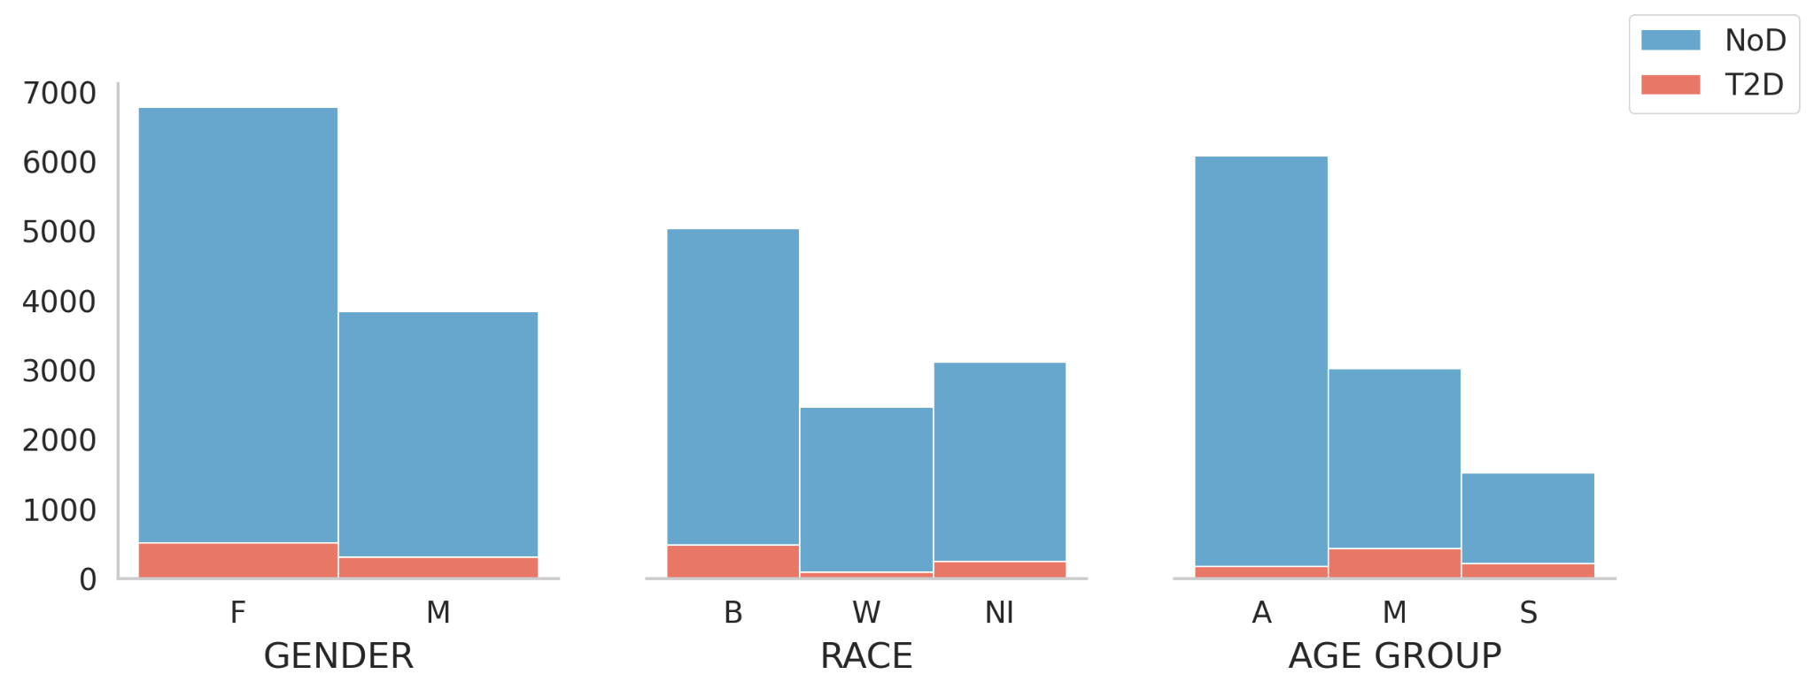
Structured Data: Demographics
» Back
Females, and Black Americans are the majority groups across outcome classes
Adult group are majority for NoD and Middle-age group are the majority for T2D

Slide 52
Interpretability Analysis
» Back
No Diabetes Type 2 Diabetes
Layerwise Relevance Propagation (LRP)^{[1]} Heatmap
Chronic kidney disease contributes highly towards positive prediction
Unemployment also contributes positively–an important social determinant of health
[1] S. Bach, A. Binder, G. Montavon, F. Klauschen, K.-R. Muller, and W. Samek, “On pixel-wise explanations for non-linear classifier decisions by layer-wise relevance propagation,” PloS one. 2015.

Slide 53
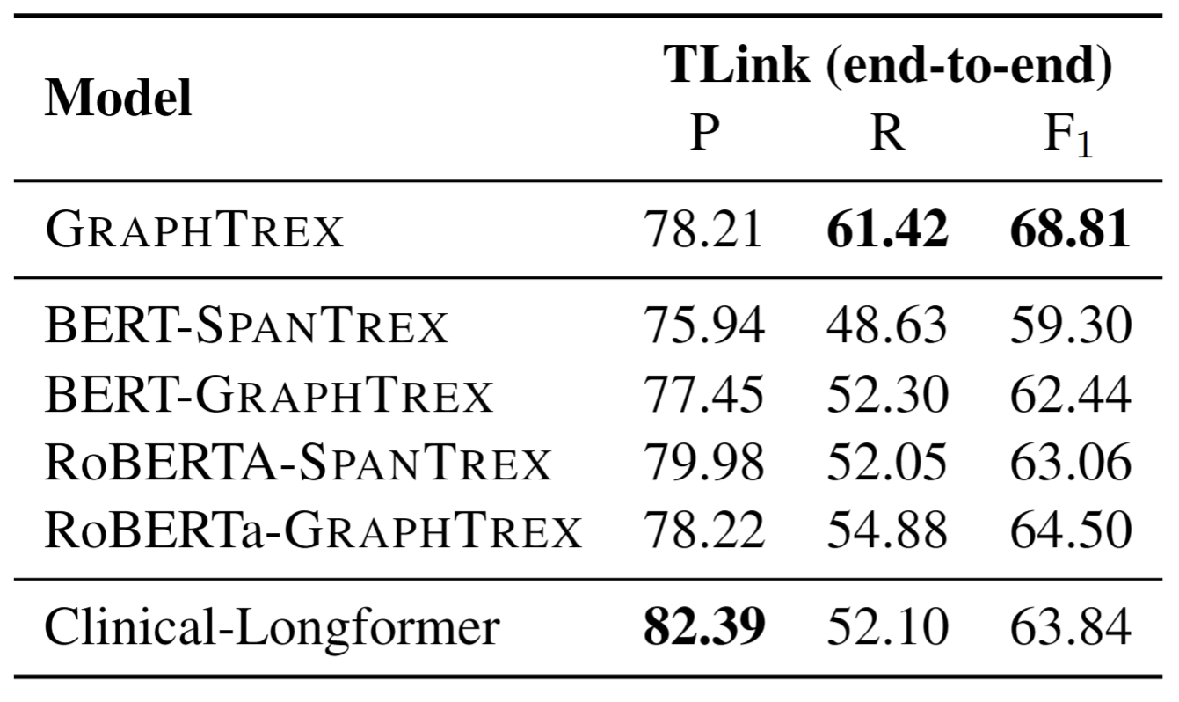
Ablation Across Different Encoders
» Back
Performance with Different Base Encoders on I2B2 2012

Slide 54
Additional Materials: Part 3

Slide 55
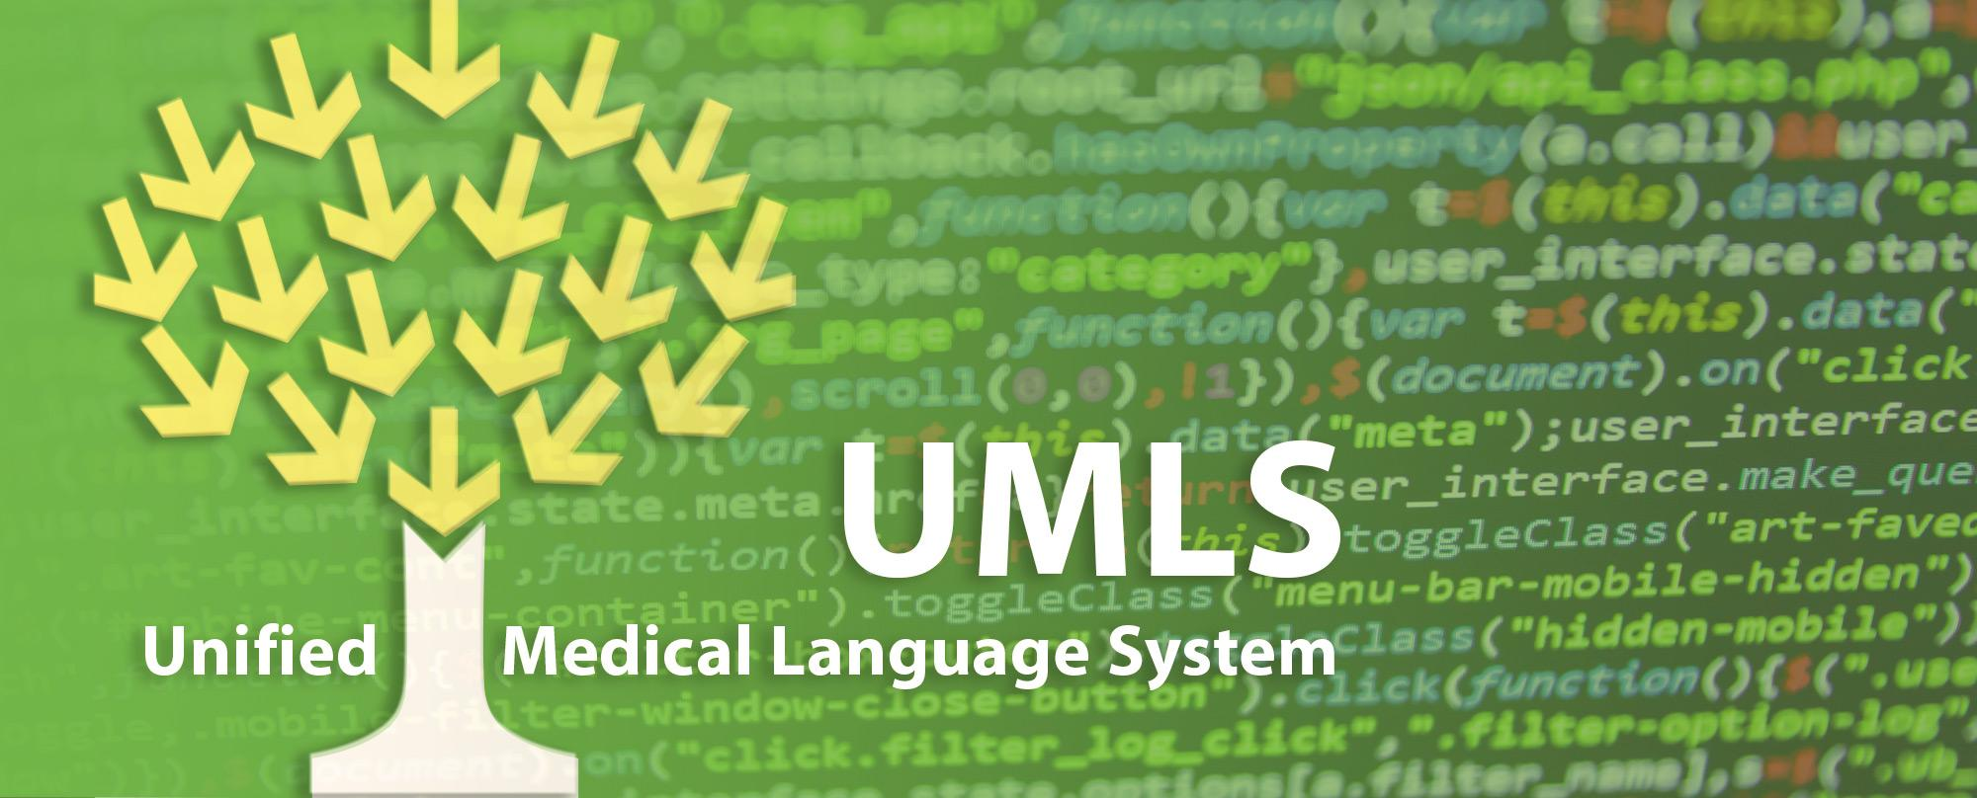

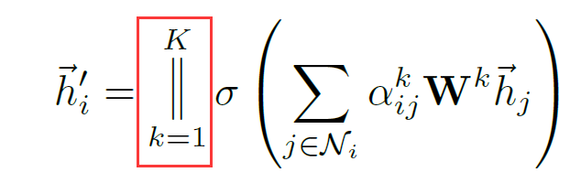
HiT-GNN
T2D/NoD
FC
+
Sigmoid
Note₁
Note₂
Note₃
BiLSTM
BiLSTM
BiLSTM
Document Level
TREx
Graph Embedding
Entity Normalization
Augment
Semantic Network
Timegraph
(Reduced, consistent graph)
Processing Note_{i}
GNN
Aggregation,
Node Pooling
KG Embedding (pretrained)
BioMedBERT

Slide 56
MIMIC-IV Data
» Back
Large, publicly available database of de-identified electronic health records (EHRs)
Patients admitted to the Beth Israel Deaconess Medical Center in Boston between 2008 and 2019.
Successor to earlier releases MIMIC-II and MIMIC-III
Exclusion Criteria for data curation:
Diagnosis of Type 1 diabetes or other types of diabetes

Slide 57
Data Filtering: MIMIC-IV
» Back
* First Filtration Criteria: Only consider patients with some notes
Notes | T2D Patients| NoD Patients
Initial Data
(excluding other types of Diabetes, RACE=Others)
01
4,033,399 | 14,101 | 142,412
Drop Pre-Diagnosed (Earliest_Dx_Date)
3,220,793 | 5,952 |142,412
Drop if >20 Admissions (already high risk patients)
235,727 | 5,847 | 59,566
Drop duplicated and non-verbal notes
184,421 | 5,272 | 54,803
note length within .05-.95 quantile
175,201 | 5,207 | 54,170
Drop duplicated sections
(adjusts Earliest_dx_Date)
174,995 | 5,207 | 106222
LLM + Matched Control sampling
(adjusts Earliest_dx_Date)
14,957 | 2,909 | 2,909

Slide 58
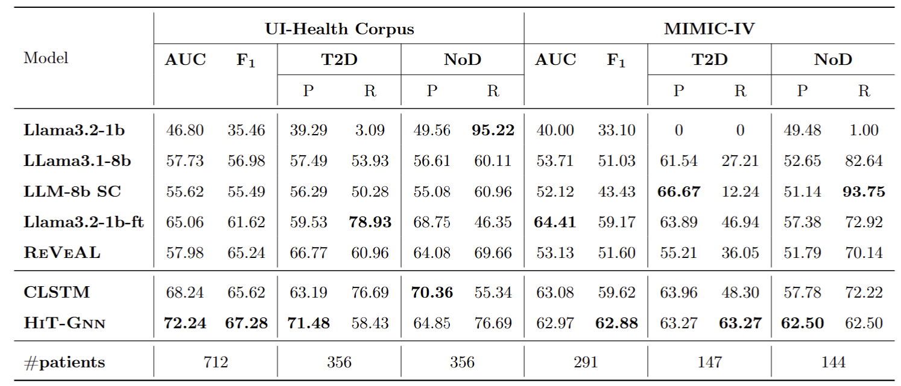
Part-3 Results
» Back

Slide 59
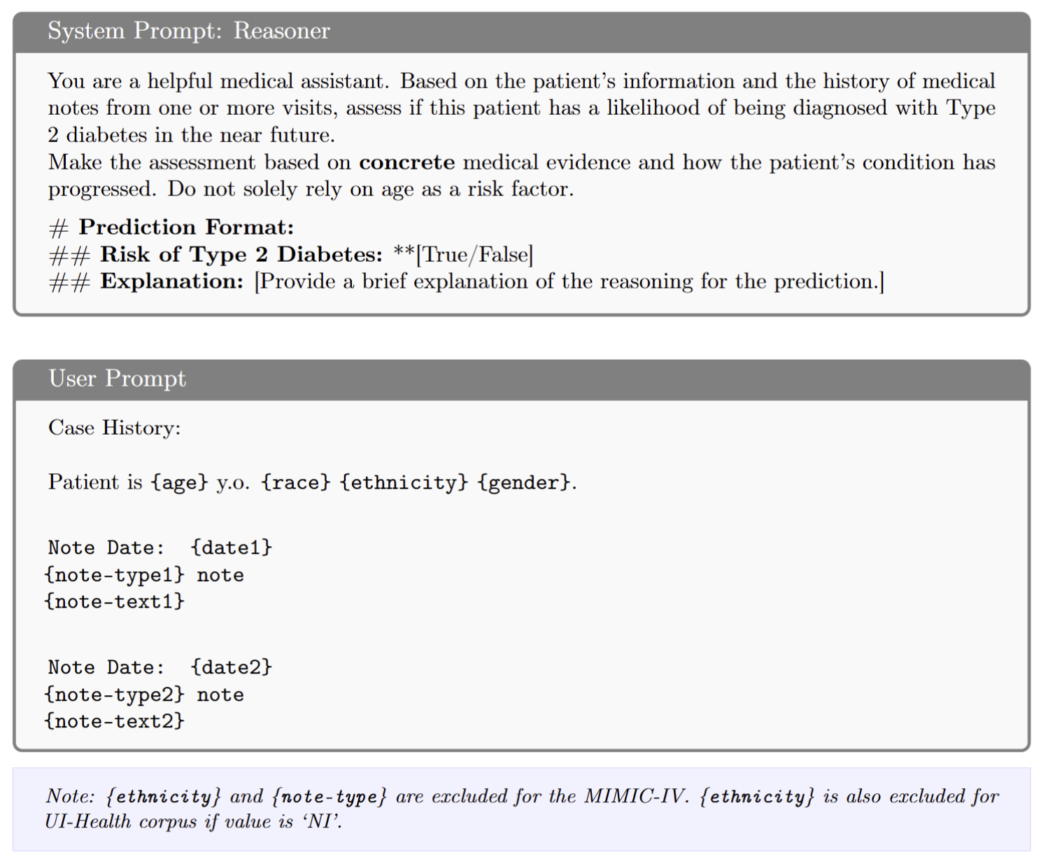
Prompts
» Back
Prompt instructing an LLM to predict future risk of Type 2 Diabetes with explanation
from patient demographics and sequence of clinical notes

Slide 60
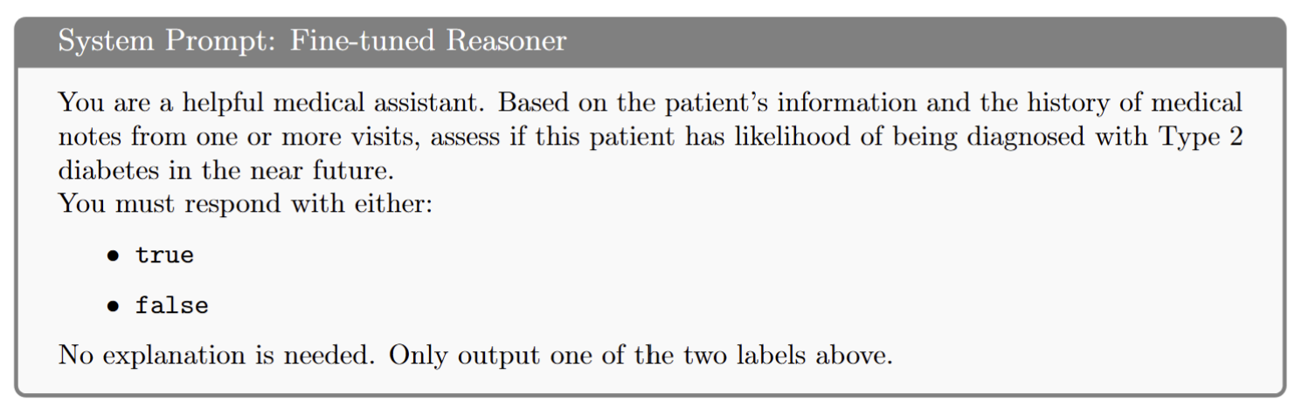
Prompts
» Back
Fine-tuned LLM prompt to predict future risk of Type 2 Diabetes
from patient demographics and sequence of clinical notes

